Slide 1
BLG 459E COMPUTER SECURITY
The Battle Against Phishing: Comparing Various Machine Learning Models for
Email Threat Mitigation
Ahmet Emre Buz 150200010
Mustafa Can Çalışkan 150200097
Umut Ural 150200013
Yusuf Emir Sezgin 150200066

Slide 2
BACKGROUND / RELATED WORK
Phishing in Cybersecurity
Definition: Fraudulent emails aiming to steal sensitive data (passwords, bank details).
Impact:
347.3 billion daily emails (2023); 56.5% classified as spam.
Over 100,000 phishing targets daily.
Financial sector most affected (23.5% of attempts in Q2 2023).
Limitations of Traditional Methods:
Dependence on static rules and patterns.
Inability to adapt to evolving attack strategies.
Role of Machine Learning:
Dynamic adaptation to new threats.
Higher accuracy and recall in phishing detection.
Significant Contributions:
Hybrid Models: HLSTMCNN combining LSTM and CNN achieved 99.86% accuracy.
Deep Learning: Use of GloVe embeddings and dimensionality reduction for feature extraction.
Siamese Neural Networks: Authorship verification models enhanced phishing detection.
Insights from Prior Studies:
Importance of ensemble methods (e.g., stacking, soft voting).
Challenges of unbalanced datasets and feature representation.
Role of psychological factors in user susceptibility.

Slide 3
PROPOSED SOLUTION
Objective: Design a robust ML-based framework for phishing detection.
Models Evaluated:
Gaussian Naive Bayes: Fast and efficient but limited to simple relationships.
K-Nearest Neighbors: Sensitive to k value; useful for localized data.
Logistic Regression: Simple, interpretable, and highly generalizable.
Random Forest: Handles complex patterns with high recall.
Methodology:
Data preprocessing: Noise removal, text cleaning, and tokenization.
Feature extraction: Vectorization of email subject, sender, content, and URL detection.
Performance evaluation: Metrics include accuracy, precision, recall, and F1-score.

Slide 4
EXPERIMENTAL SETUP
Dataset:
Real-world email datasets from publicly available sources.
Features: Vectorized email content, sender info, and binary URL presence.
Training and Testing:
Varying training data splits (20%–90%) to analyze scalability and performance under different data availability.
Models Evaluated:
Gaussian Naive Bayes, KNN, Logistic Regression, Random Forest.
Evaluation Metrics:
Accuracy: Correct classifications across all emails.
Precision: Accuracy of positive classifications (phishing emails).
Recall: Ability to correctly identify phishing emails.
F1-Score: Harmonic mean of precision and recall.

Slide 5
MODEL PERFORMANCE
Gaussian Naive Bayes (GNB):
Strengths: Computationally efficient.
Weaknesses: Struggles with complex patterns; high false negatives (660).
Key Metric: Recall = 85.2%.
K-Nearest Neighbors (KNN):
Strengths: High recall with small k.
Weaknesses: Computational cost rises with data size; sensitive to outliers.
Key Metric: Recall = 99.1% (k=5); False positives = 1309.
Logistic Regression (LR):
Strengths: High recall, precision, and simplicity.
Weaknesses: Limited in capturing non-linear relationships.
Key Metric: Recall = 98.5%; Precision = 98.0%.
Random Forest (RF):
Strengths: Superior recall and accuracy; captures complex relationships.
Weaknesses: Higher computational cost.
Key Metric: Recall = 98.7%; Precision = 98.6%.

Slide 6
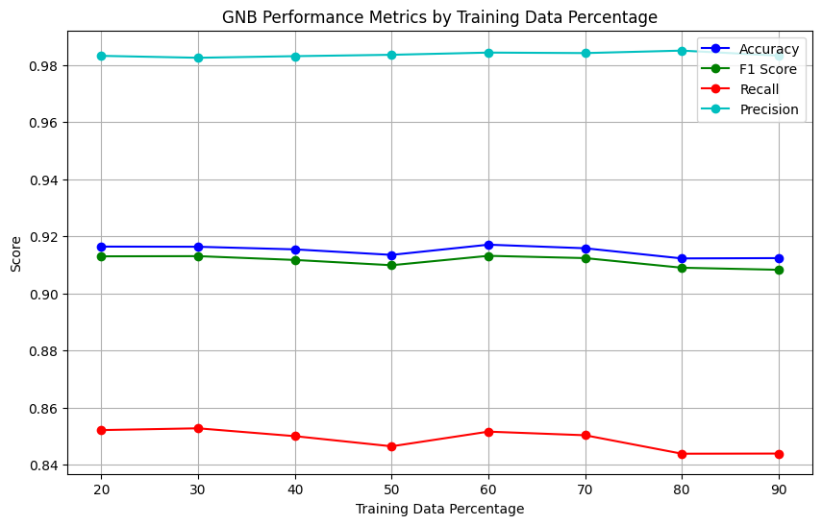
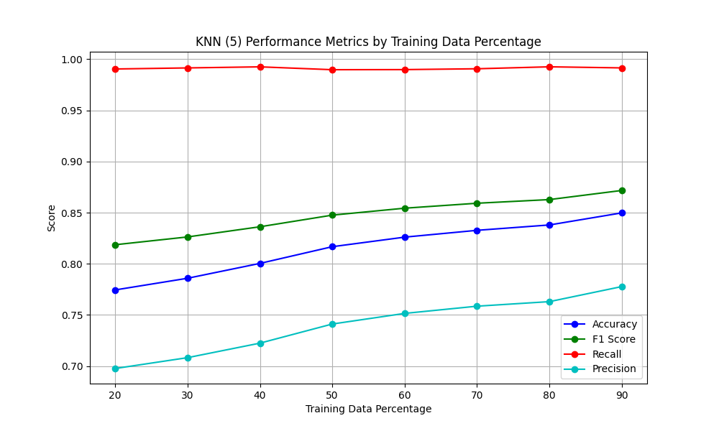
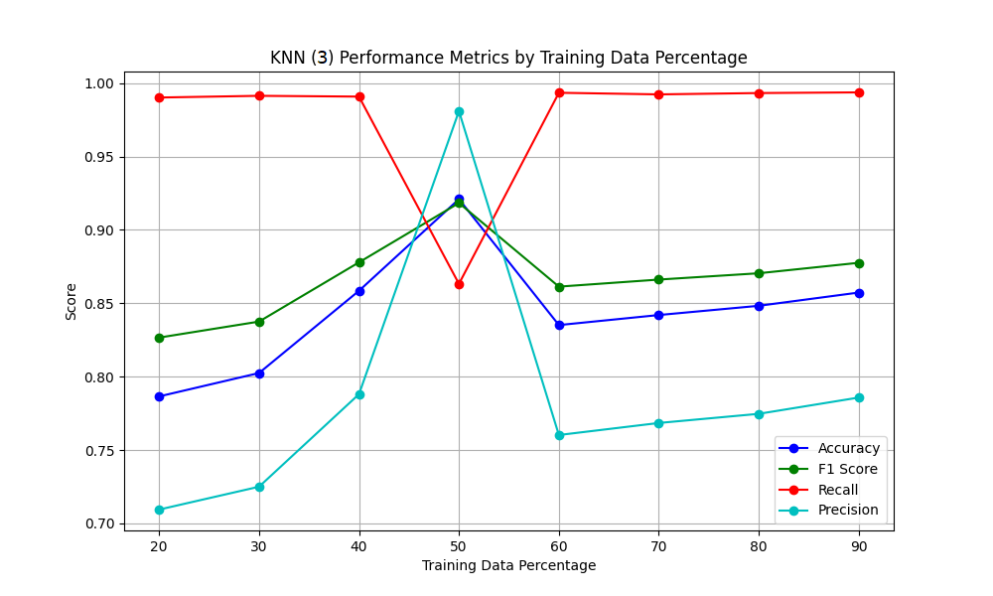
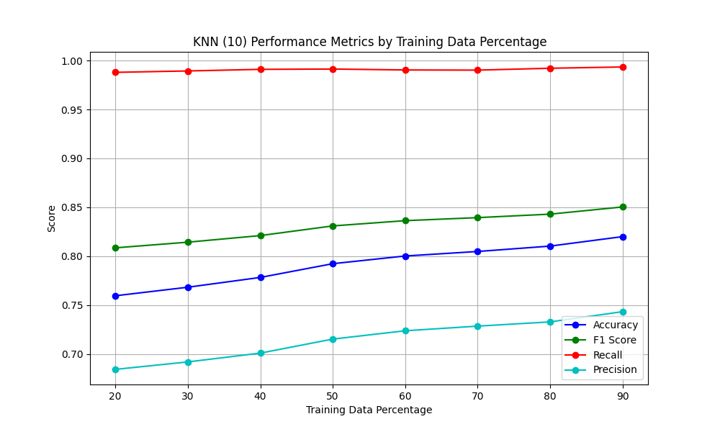

Slide 7
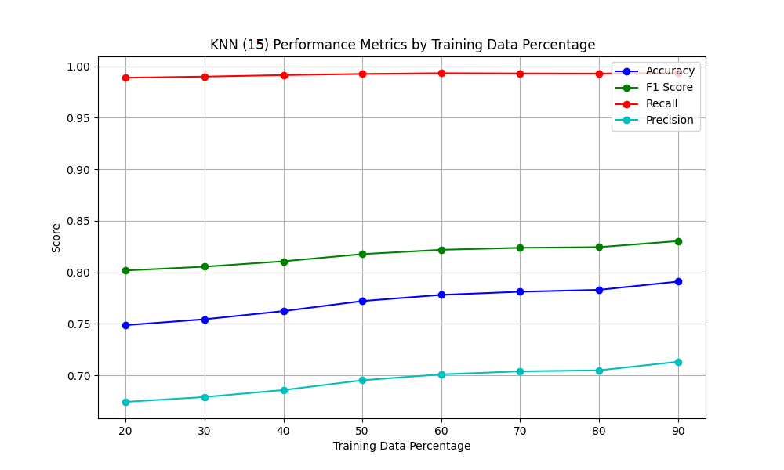
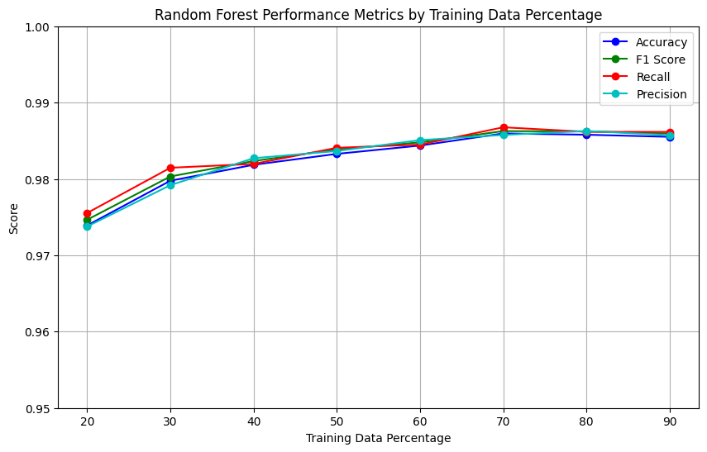
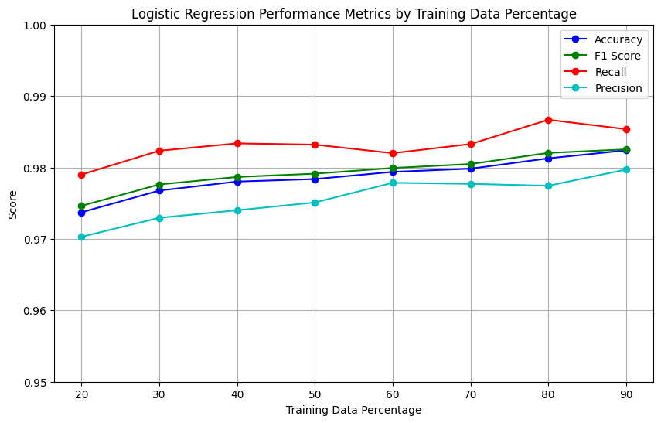
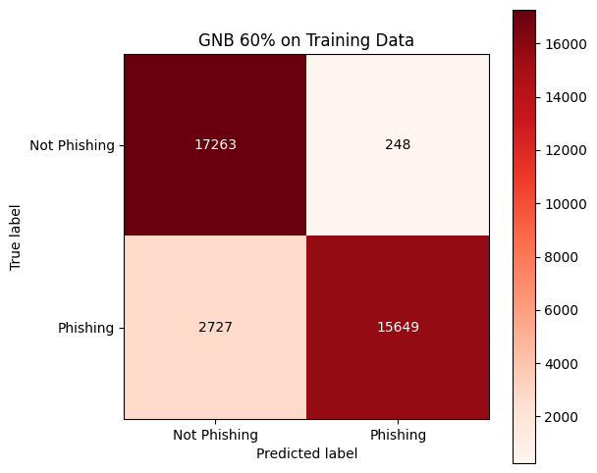
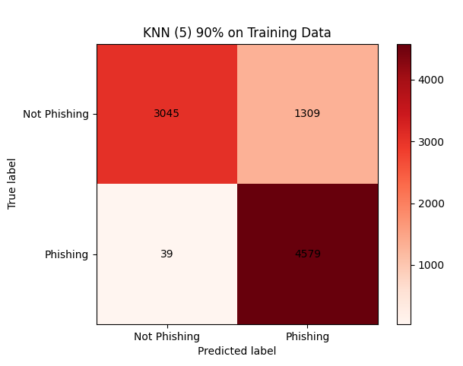

Slide 8
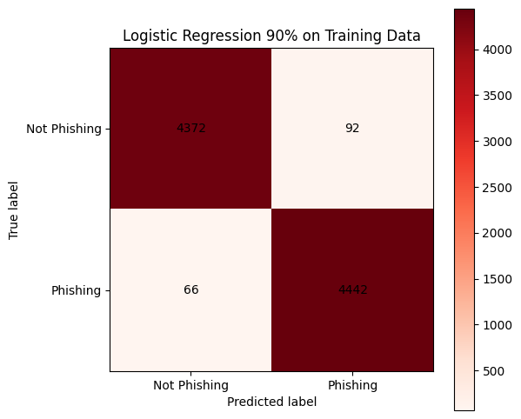
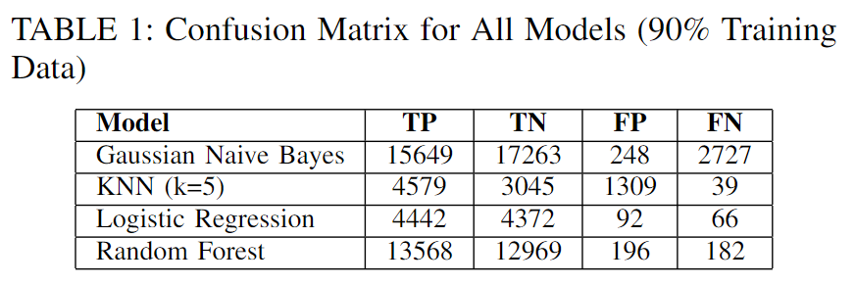
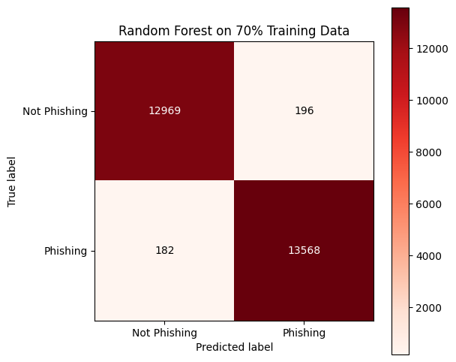
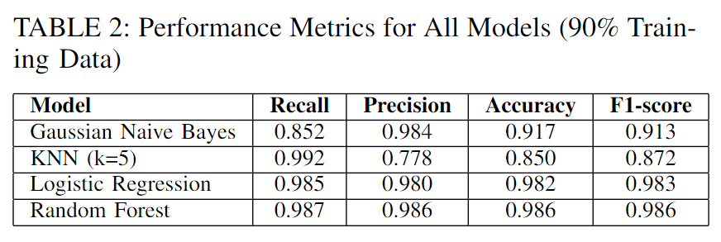

Slide 9
STRENGTHS AND WEAKNESSES
Strengths:
Logistic Regression: Simple and efficient; generalizes well to unseen data.
Random Forest: Handles complexity with high accuracy and recall.
Weaknesses:
Gaussian Naive Bayes: Limited by feature independence assumption.
KNN: Requires careful tuning and struggles with scalability in large datasets.
Trade-offs:
Balancing recall (minimizing false negatives) and precision (reducing false positives).
Computational efficiency vs. model complexity.

Slide 10
FUTURE WORK / CONCLUSION
Enhancements:
Integrate advanced NLP techniques (e.g., transformers like BERT, GPT).
Develop multilingual and cross-domain adaptable models.
Optimize for real-time detection systems with minimal latency.
Use behavioral analysis (user click patterns) alongside content-based features.
Strengthen against adversarial attacks with robust training techniques.
Privacy Considerations:
Employ federated learning for decentralized training while maintaining user privacy.
Summary
Logistic Regression and Random Forest are most effective for phishing detection.
Trade-offs between computational cost, recall, and accuracy guide model selection.
Real-World Implications
Strong defenses against phishing require adaptable and efficient models.
Future systems must address real-time applicability, privacy, and adversarial robustness.

